Slide 1

Google Wave
Joe Gregorio
Developer Relations

Slide 2
Extensions
  Wrapping it all up.

Slide 3
Extensions
- Easily use robots and gadgets
- XML file
- Metadata
- Hooks
- Actions

Slide 4
Example
<extension
name="My Gadget"
thumbnailUrl="http://...something.png"
description="A Description">
<author name="Google"/>
<menuHook
location="toolbar"
text="Add Map Gadget"
iconUrl="https://wave.png">
<insertGadget url="http://...gadget.xml"/>
</menuHook>
</extension>

Slide 5
Metadata
<extension
name="My Gadget"
thumbnailUrl="http://...something.png"
description="A Description">
<author name="Google"/>
<menuHook
location="toolbar"
text="Add Map Gadget"
iconUrl="https://wave.png">
<insertGadget url="http://...gadget.xml"/>
</menuHook>
</extension>

Slide 6
Hook
<extension
name="My Gadget"
thumbnailUrl="http://...something.png"
description="A Description">
<author name="Google"/>
<menuHook
location="toolbar"
text="Add Map Gadget"
iconUrl="https://wave.png">
<insertGadget url="http://...gadget.xml"/>
</menuHook>
</extension>

Slide 7
Action
<extension
name="My Gadget"
thumbnailUrl="http://...something.png"
description="A Description">
<author name="Google"/>
<menuHook
location="toolbar"
text="Add Map Gadget"
iconUrl="https://wave.png">
<insertGadget url="http://...gadget.xml"/>
</menuHook>
</extension>

Slide 8
Hooks
menuHook
- toolbar
- newwavemenu
regexHook
savedSearchHook

Slide 9
Actions
- addParticipants
- addSavedSearch
- annotateSelection
- insertGadget

Slide 10
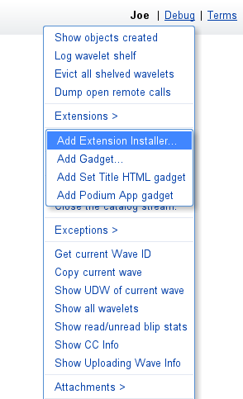
Installing the extension

Slide 11
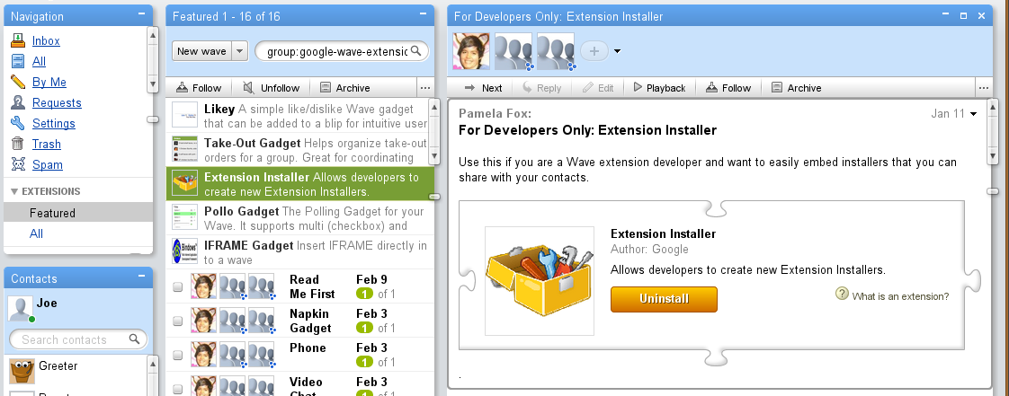
Extension installer extension

Slide 12
Exercise
- Create an extension that adds the
math bot from the last exercise
- Solution: tutorial9
- Need to serve the extension xml
- Remember that a robot is a participant

Slide 13
Gadgets and Robots
  Wonder twin powers activate

Slide 14
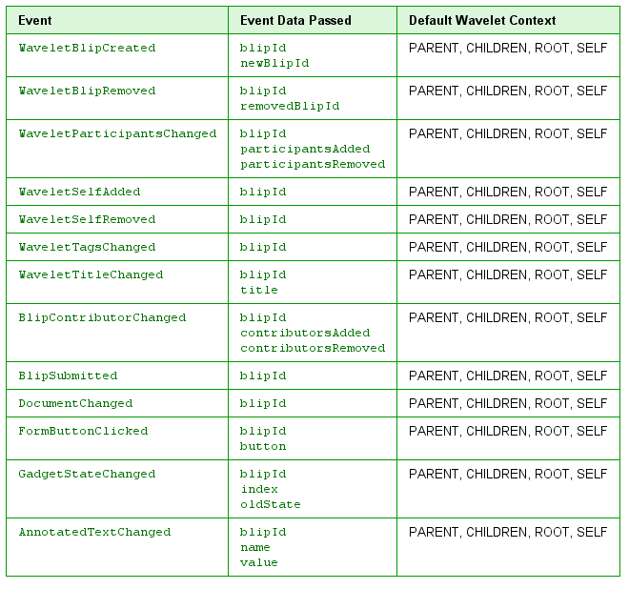
Events
Notes:
12

Slide 15
Exercise
- Start with the last exercise
- Create a robot that adds the gadget
- Have the robot comment when
the gadget state changes
- Solution: tutorial8

Slide 16
Thank You
  Questions?

